Slide 1


Smart Trial Studio
Presented By: Kashmira Chaudhari ID: 20158

Slide 2
Outline
Introduction
Tech Stack
Architecture Diagram
Use Case Diagram
User and Store Flowchart
Database
Project Structure
API End Points
Project Execution
Challenges
Conclusion

Slide 3
Introduction
Revolutionizing the way we whop for clothing: The Smart Trial Studio offers an innovative approach to shopping.
The kiosk has been introduced in the project to streamline the shopping experience by allowing customers to browse products, manage their cart, and place orders directly from an intuitive interface.
Enhanced Shopping Experience: This service reduces the time and hassle of traditional shopping while enhancing the overall experience with personalized convenience and flexibility

Slide 4
Tech Stack
Sprinboot: Java Spring Boot is an open-source tool that makes it easier to use Java-based
frameworks to create microservices and web apps.
Java: Java is a versatile, object-oriented programming language designed for building platform-independent,
secure, and high-performance applications.
Mongodb: MongoDB is the document database designed to make it easy for developers to work with data in
any form, and from any programming language.
HTML: HTML (HyperText Markup Language) is the standard language used to create and structure content on
the web by defining elements like text, images, and links.
JavaScript: JavaScript is a dynamic, high-level programming language primarily used to create interactive and
responsive behavior on web pages.
CSS: CSS (Cascading Style Sheets) is a stylesheet language used to control the presentation, layout, and
design of HTML elements on a web page.

Slide 5
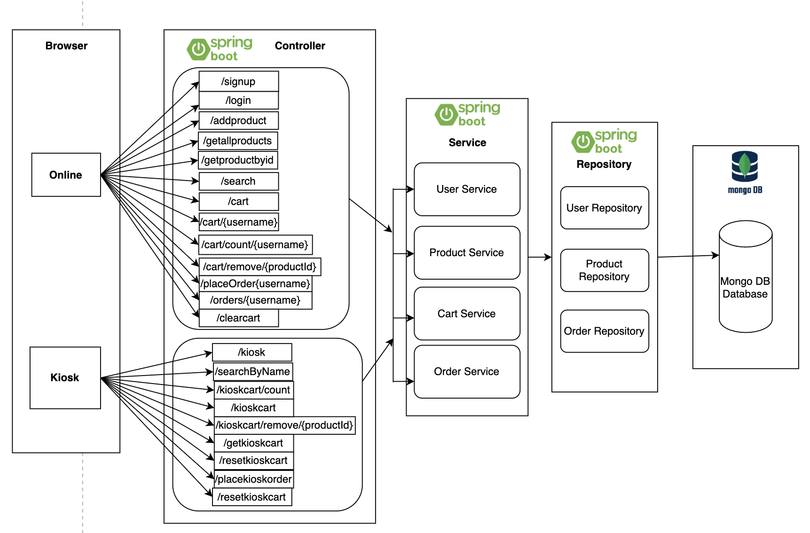
Architecture Diagram
Fig: Architecture of Smart Trial Studio

Slide 6
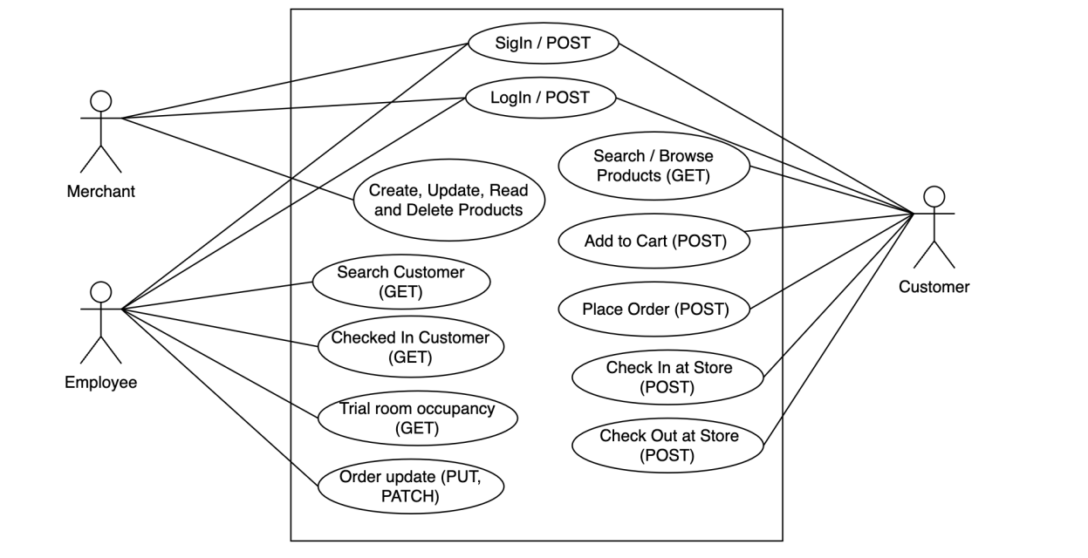
Use Case Diagram
Fig: Use case for Smart Trial Studio

Slide 7
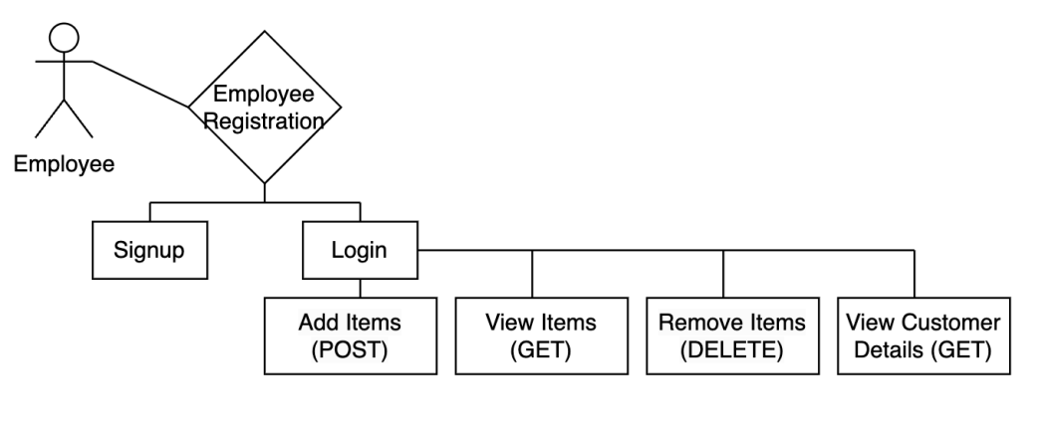
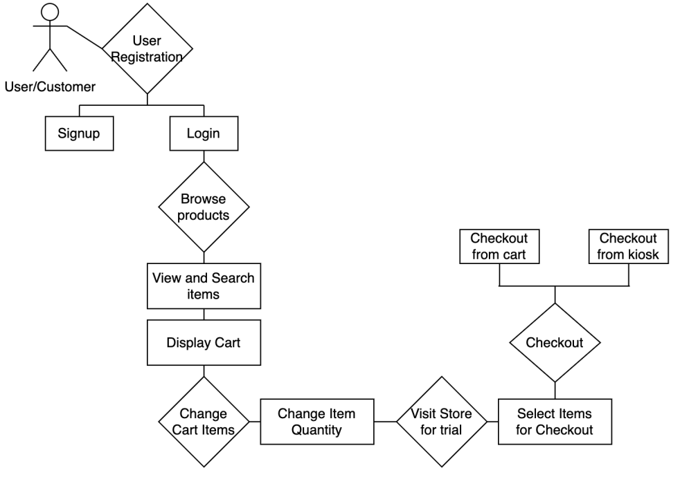
User and Store Flowchart
Fig: User Flowchart
Fig: Store Flowchart

Slide 8
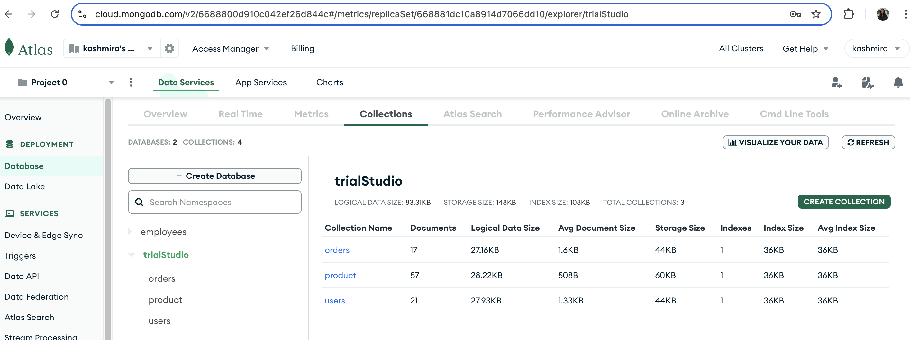
Database
MongoDB is a NoSQL, document-oriented database that stores data in flexible, JSON-like documents, allowing for dynamic schema design. It is designed for high performance, scalability, and ease of development, making it ideal for modern applications with evolving data structures.
Collections (Tables)
user
product
orders

Slide 9
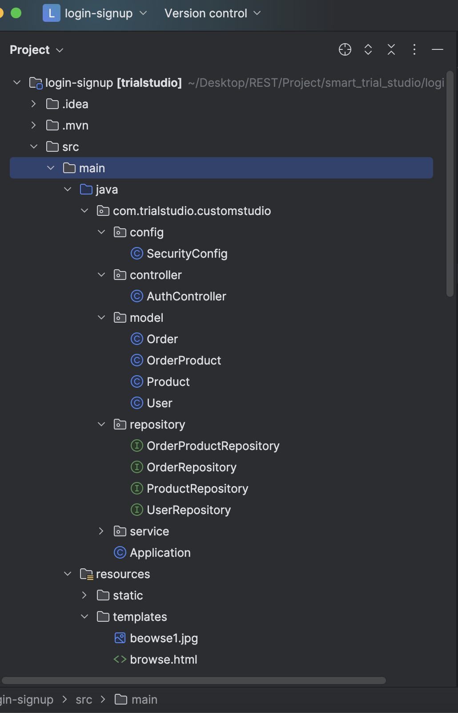
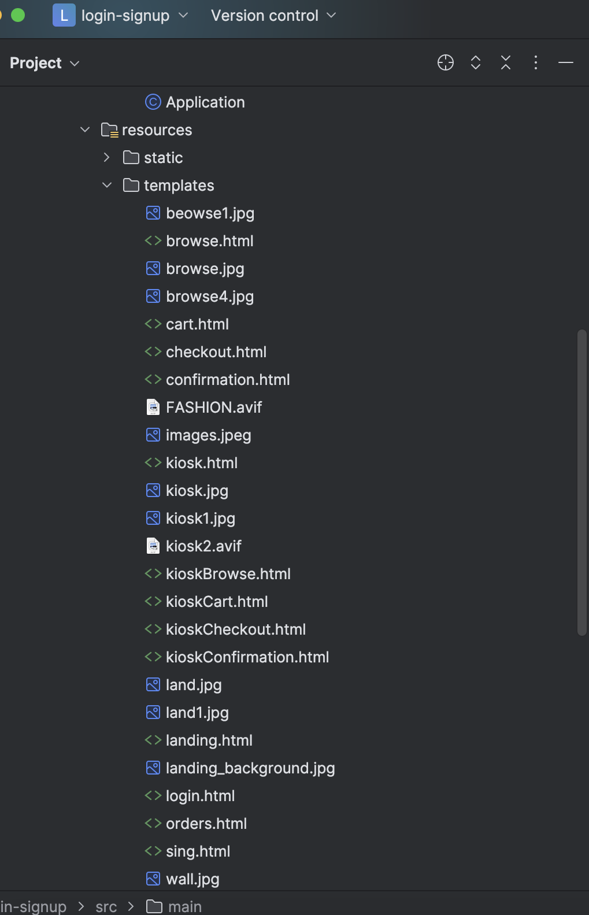
Project Structure

Slide 10
API End Points
Online API’s
@PostMapping("/signup")
@PostMapping("/login")
@PostMapping("/addproduct")
@GetMapping("/getallproducts")
@GetMapping("/getproductbyid")
@DeleteMapping("/deleteproductbyid")
@GetMapping("/search")
@PutMapping("/{id}")
@PatchMapping("/{id}")
@GetMapping("/login")
@GetMapping("/signup")
@PostMapping("/cart")
@GetMapping("/cart/{username}")
@GetMapping("/cart/count/{username}")
@PostMapping("/placeOrder/{username}")
@GetMapping("orders/{username}")
Kiosk API’s
@GetMapping("/kiosk/count")
@GetMapping("/searchByName")
@PostMapping("/kioskcart")
@DeleteMapping("/kioskcart/remove/{productId}")
@GetMapping("/getkioskcart")
@GetMapping("/kioskcart/count")
@GetMapping("/resetkioskcart")
@PostMapping("/placekioskorder")
@PostMapping("/clearcart")
@PostMapping("/resetkioskcart")

Slide 11
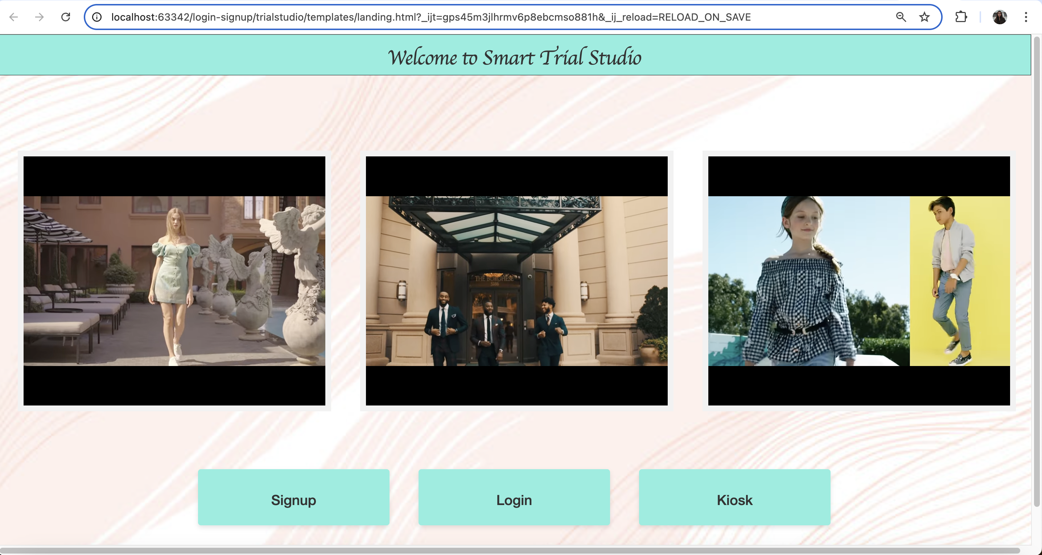
Project Execution
Video source YouTube
Landing Page

Slide 12
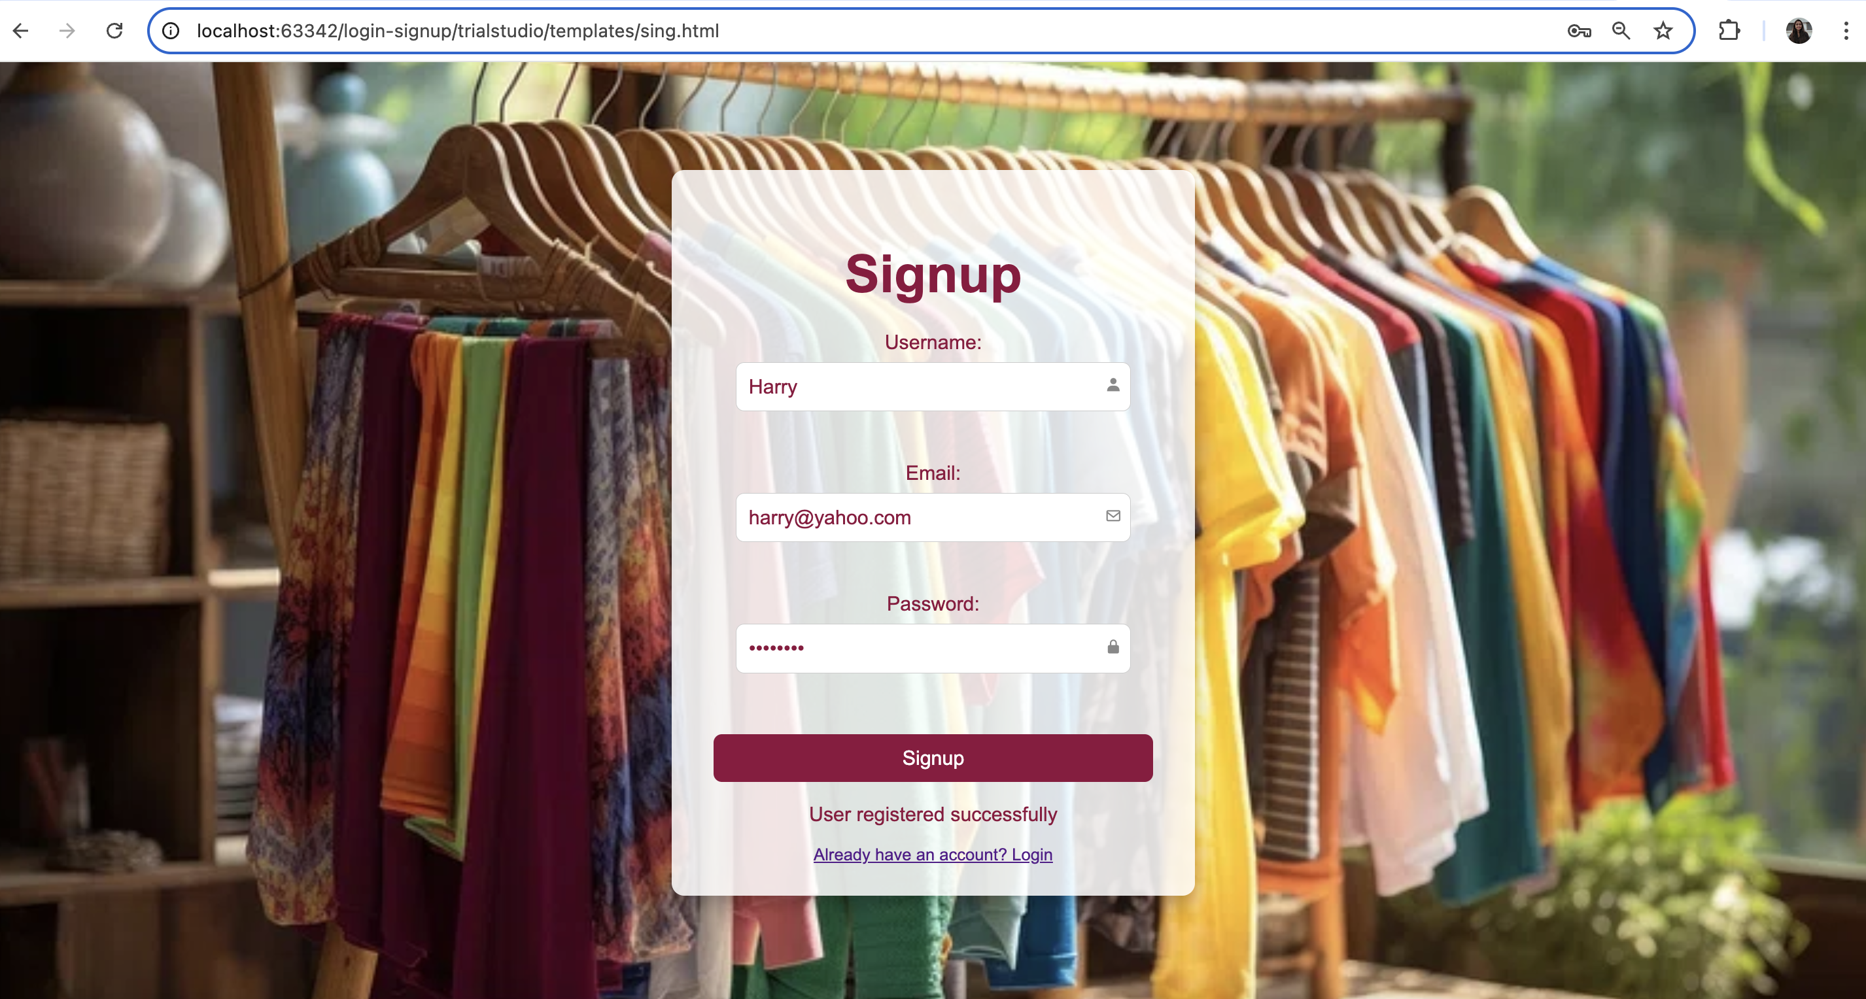
Signup page

Slide 13
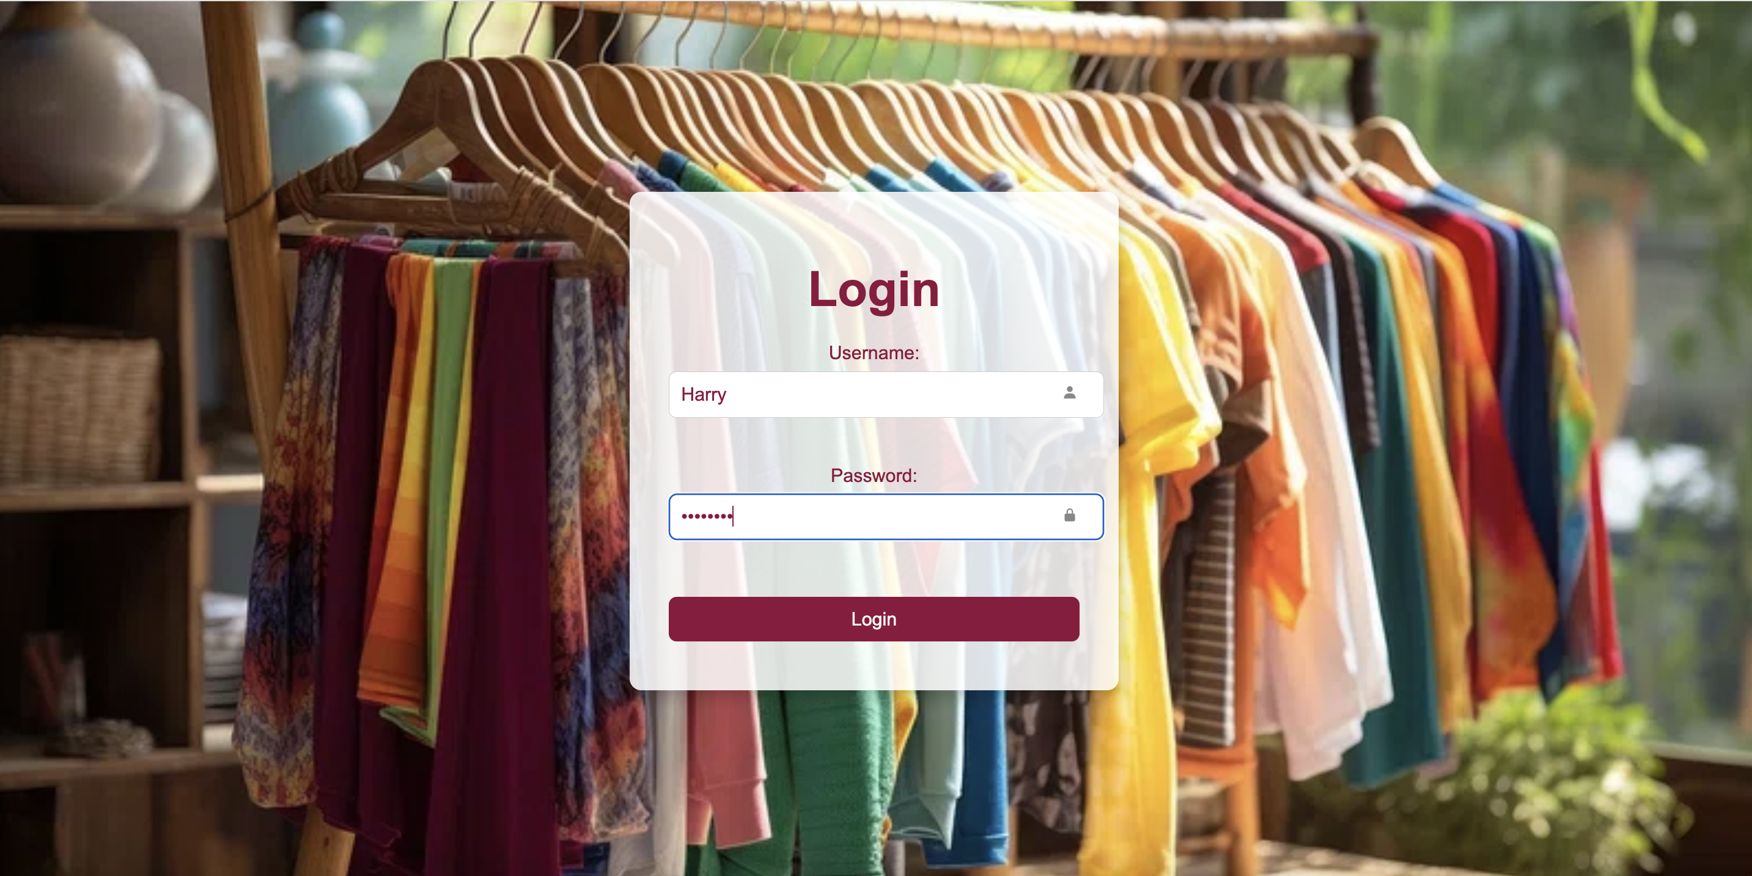
Login page

Slide 14
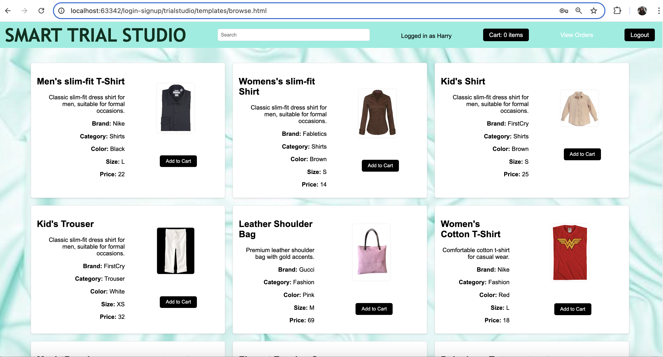
Browser page

Slide 15
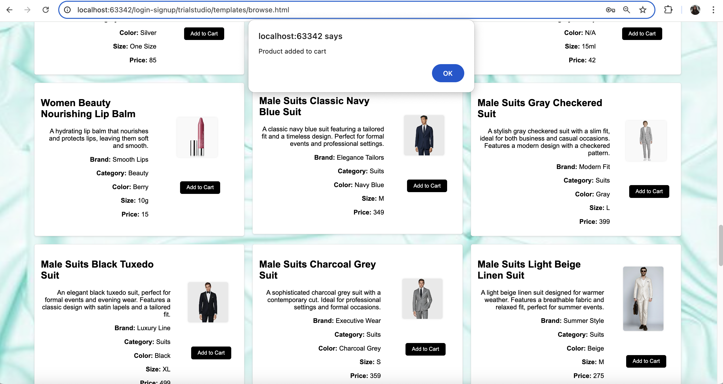
Product added to cart

Slide 16
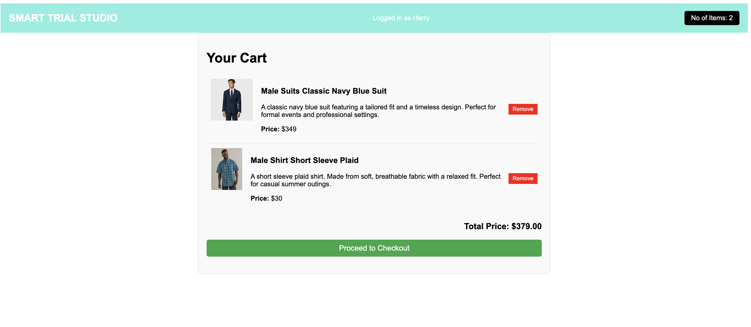
Cart page

Slide 17
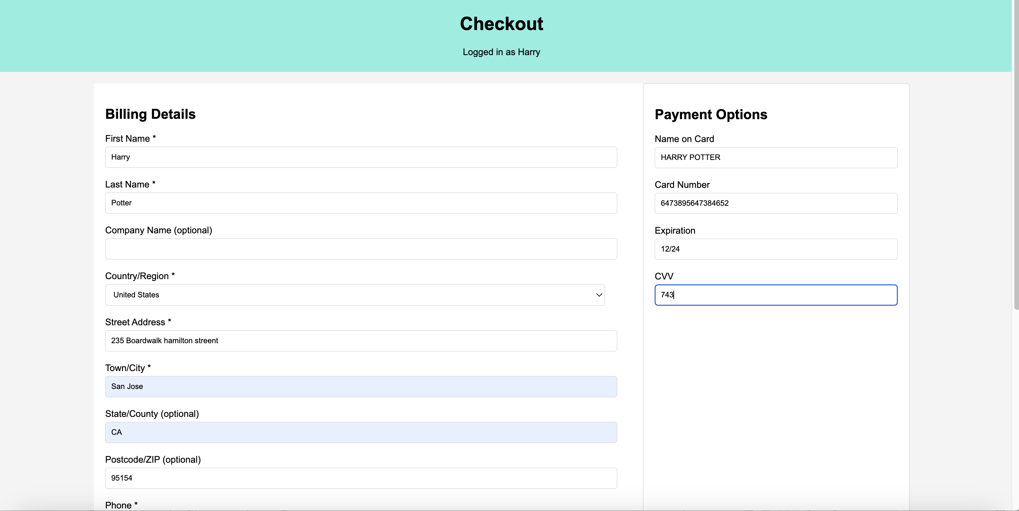
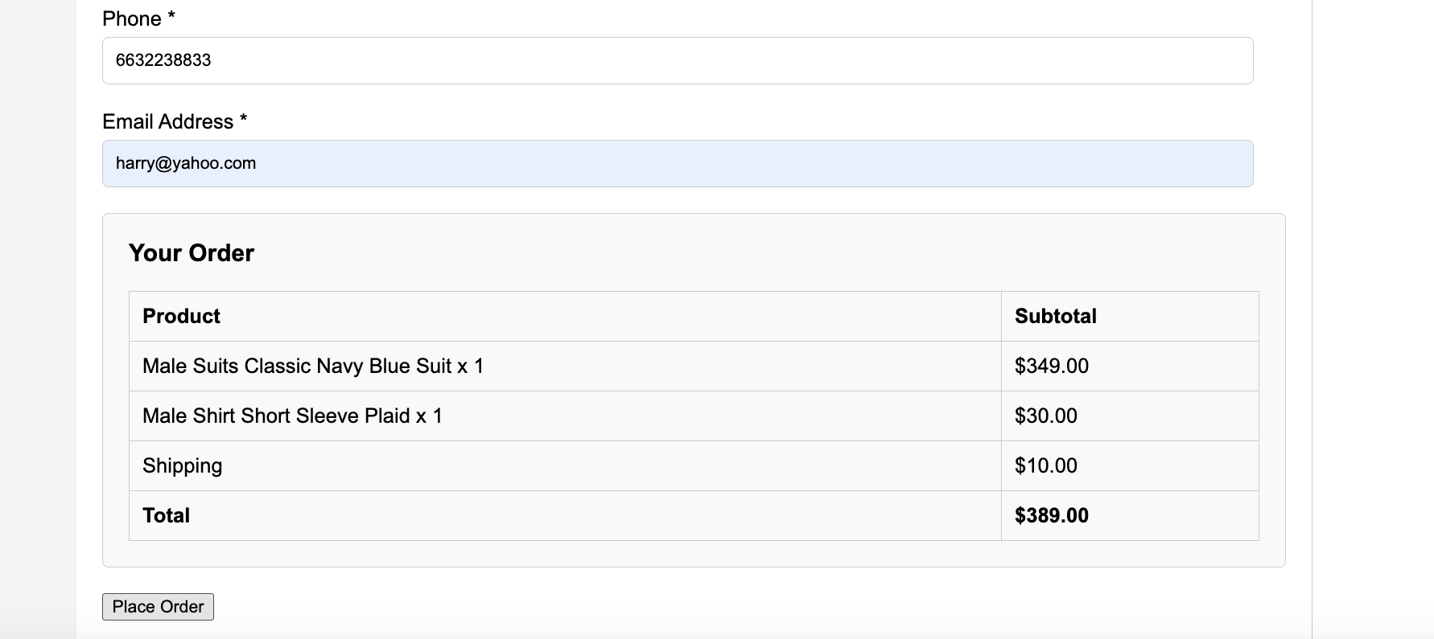
Checkout page

Slide 18
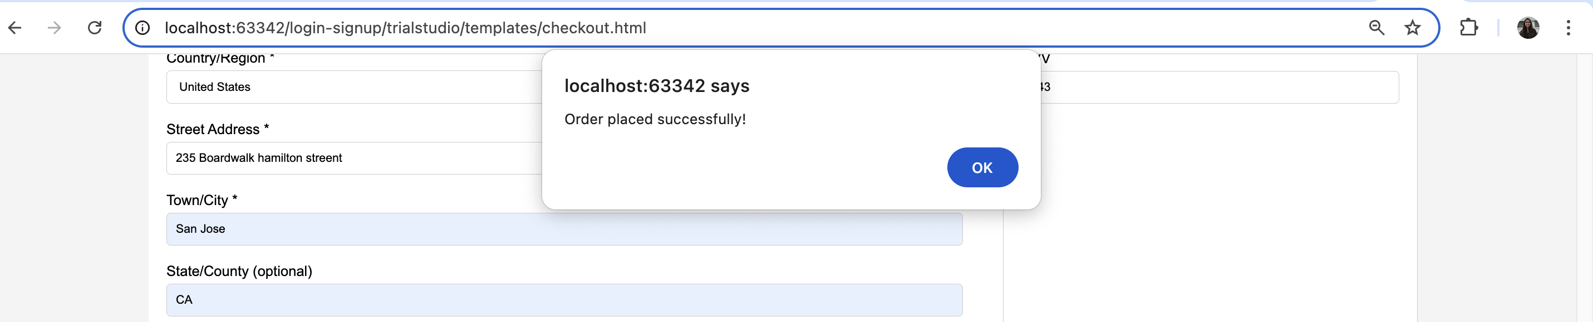
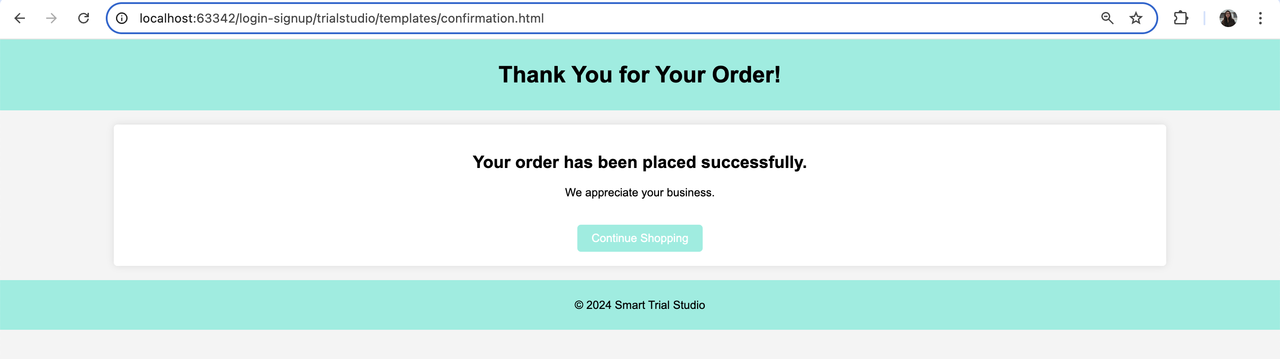
Order Confirmation

Slide 19
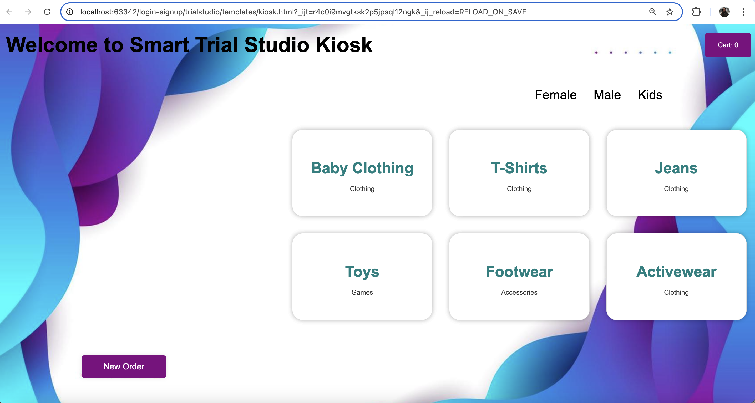
Kiosk Page
Kids

Slide 20
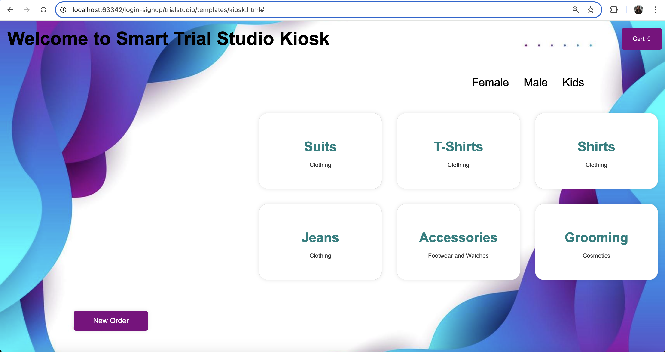

Female
Male

Slide 21
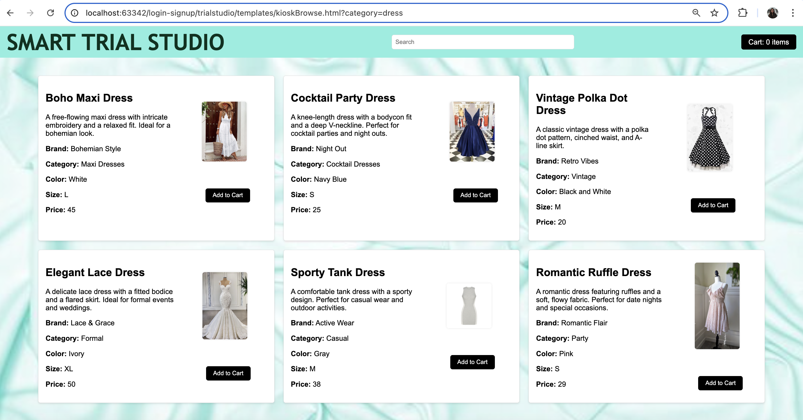
Browse products on kiosk

Slide 22
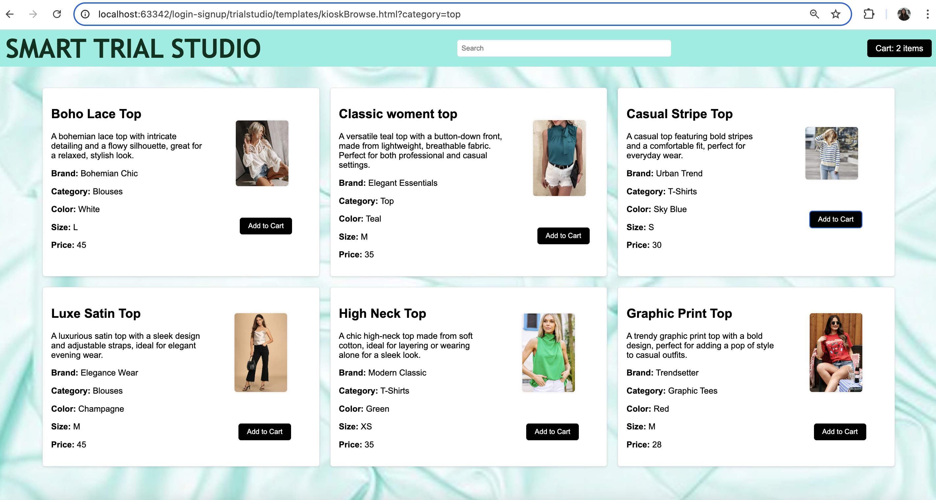
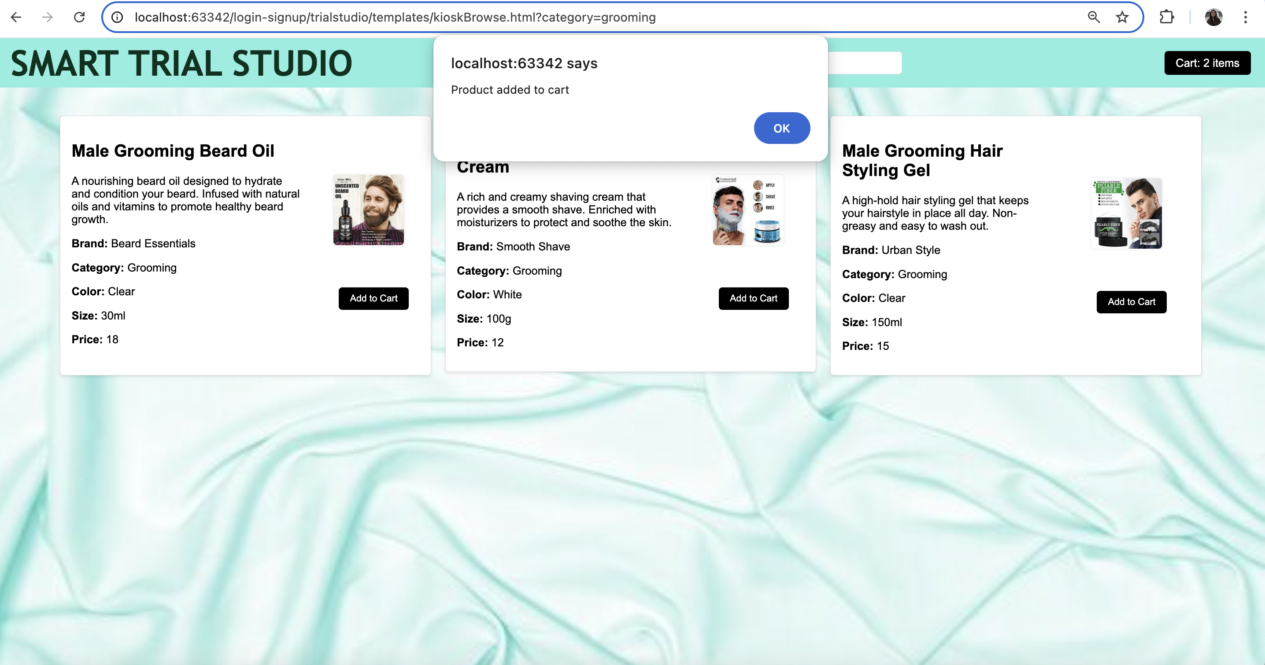

Slide 23
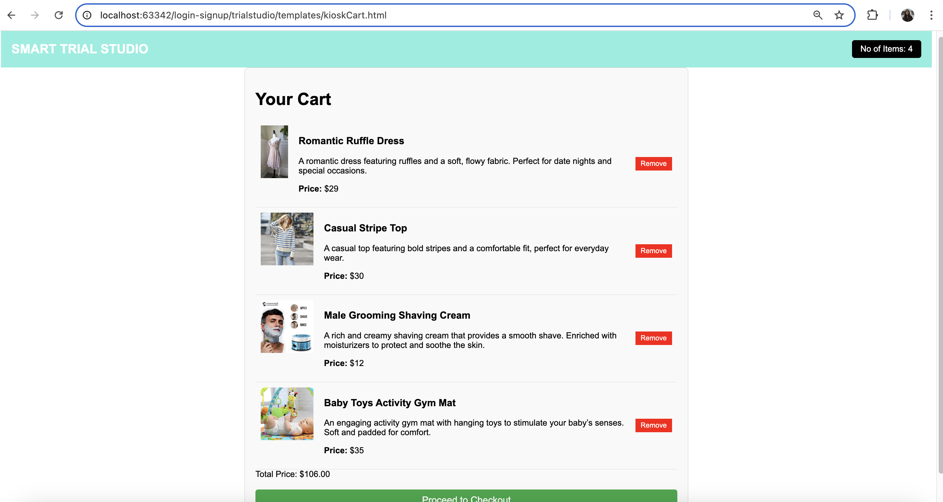
Kiosk cart

Slide 24
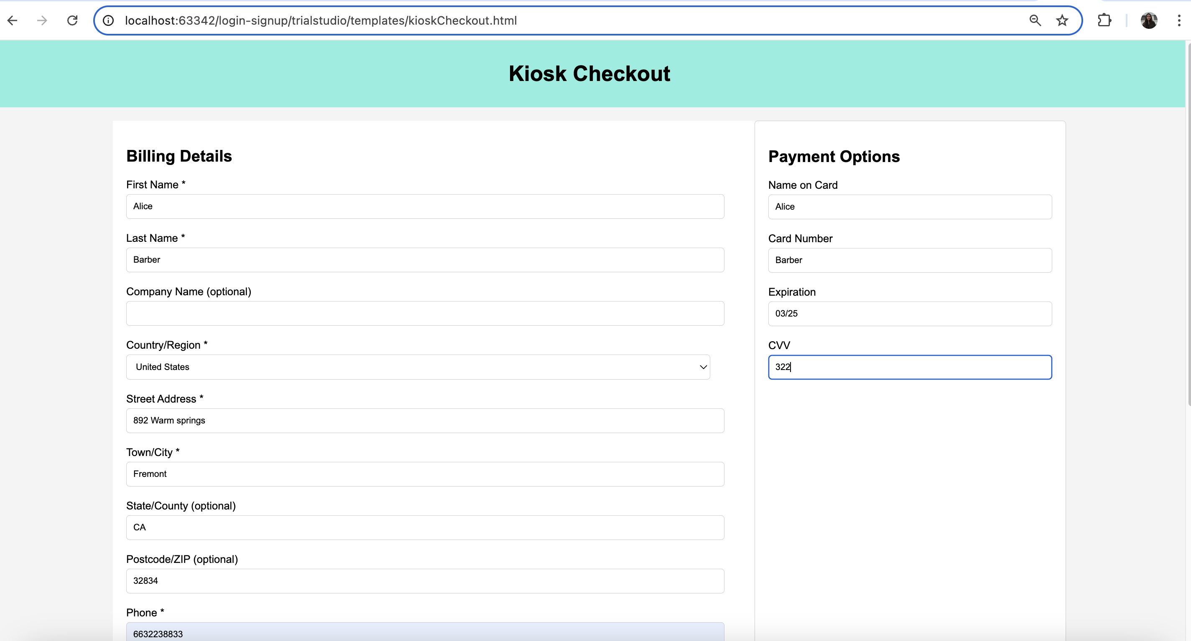
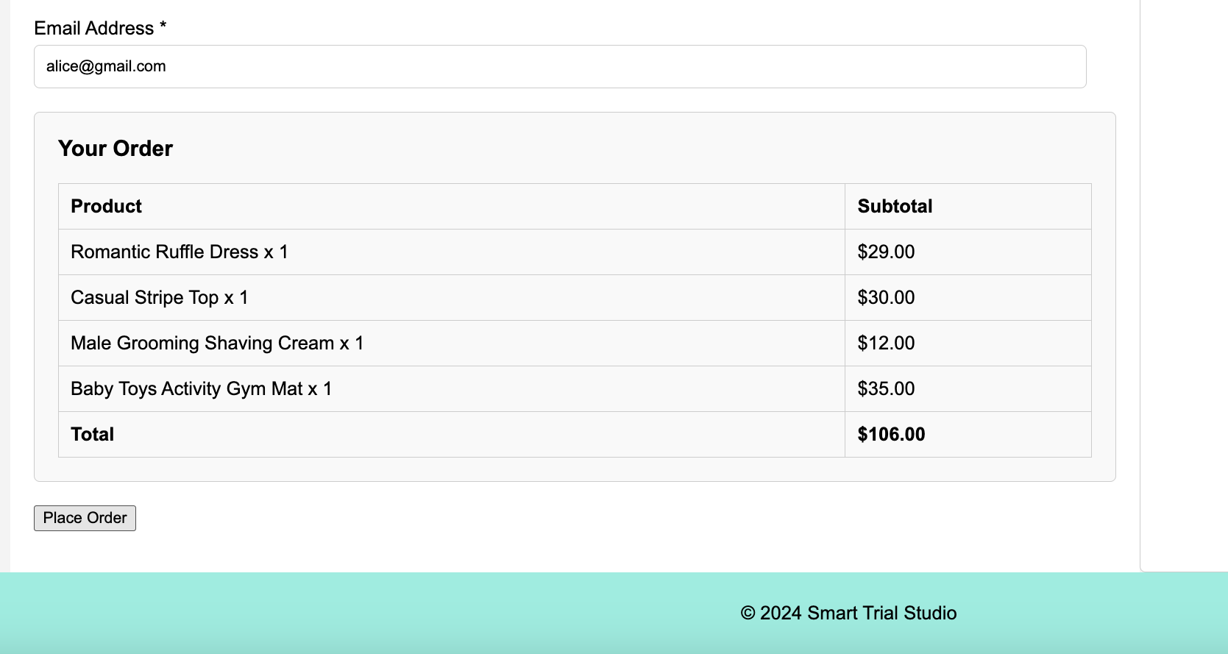
Kiosk Checkout page

Slide 25
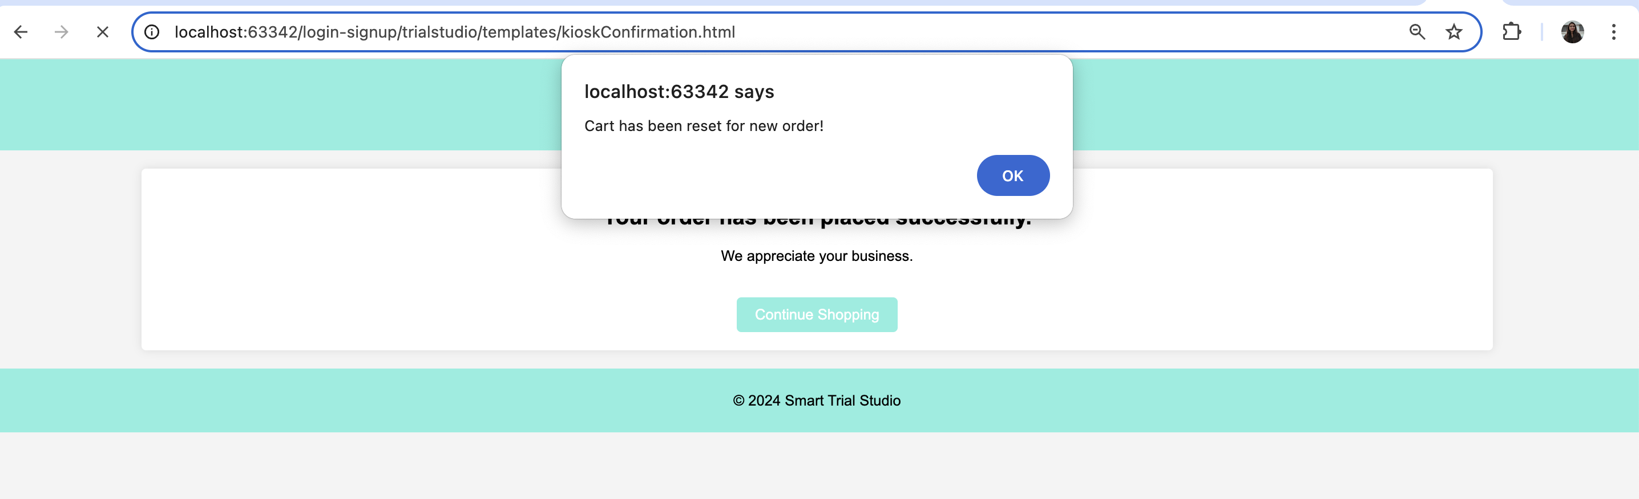
Order Confirmation

Slide 26
Challenges
Mongodb connection: I faced some issues when trying to connect to MongoDB, which is the database I used for the project. The connection kept failing due to problems like incorrect settings and outdated software versions. After some troubleshooting, I figured out the issue was with the network configuration and the database driver. Once I fixed these, the connection worked, and I could continue with the project.
Security Configs: I had trouble with the security settings when connecting to MongoDB. The database kept blocking my access because the security configurations were too strict. After adjusting the permissions and making sure my credentials were correct, I was finally able to connect and move forward with the project.
API execution: I ran into issues while creating the REST API for my project. The problem was that some of the endpoints weren't working correctly because of mistakes in how I set up the routes and handled requests. After debugging and fixing the code, the API started functioning as expected, and I could connect it to the rest of the application.

Slide 27
Conclusion:
In conclusion, I successfully built both the API and the front-end pages for "The Smart Trial Studio," ensuring everything works seamlessly together.
I managed to connect the front-end with the back-end using the tech stack we selected, including Spring Boot and MongoDB.
Despite facing challenges along the way, such as dealing with connectivity issues and setting up security configurations, I was able to overcome them effectively.
Additionally, I developed a complete end-to-end kiosk system from scratch, making the shopping experience more integrated and user-friendly.
This project has streamlined the way customers shop for clothing, bridging the gap between online and in-store trials.

